Slide 1
Occupational English Test
Ahmad almakableh

Slide 2
What is the OET
Is an Australian language exam to substitute IELETS for the all medical field
The IELTS (International English Language Testing System) and OET (Occupational English Test) are both used to test the English Language competency of healthcare professionals around the world. Both of these examinations are chosen by the regulatory bodies to make sure that healthcare workers have sufficient language skills to communicate effectively with patients and colleagues and deliver adequate medical care.

Slide 3
What is the difference between OET and IELTS?
Usually OET tests a person’s ability to communicate in English in healthcare setting, whereas IELTS test the ability of person to communicate in English in general. Although both the exams are accepted by the GMC and the NMC.
IELTS VS OET Key Differences:
Many think that OET is much easier to pass than Academic IELTS. This is not entirely true. People think so, because many health care professionals who sat for the OET test for the first time, had passed the exam. This was not because the test was easier. It happened because, their communication skill had been assessed in an environment which was familiar to them.

Slide 4
Similarities:
There 4 sub tests in both exams: Reading, Listening, Writing, Speaking.
In both tests students receive a graded score rather than pass or fail.
Both a ‘7’ in IELTS and a ‘B’ on the OET is considered C1 or advanced level of English by the common European Frame work of reference

Slide 5
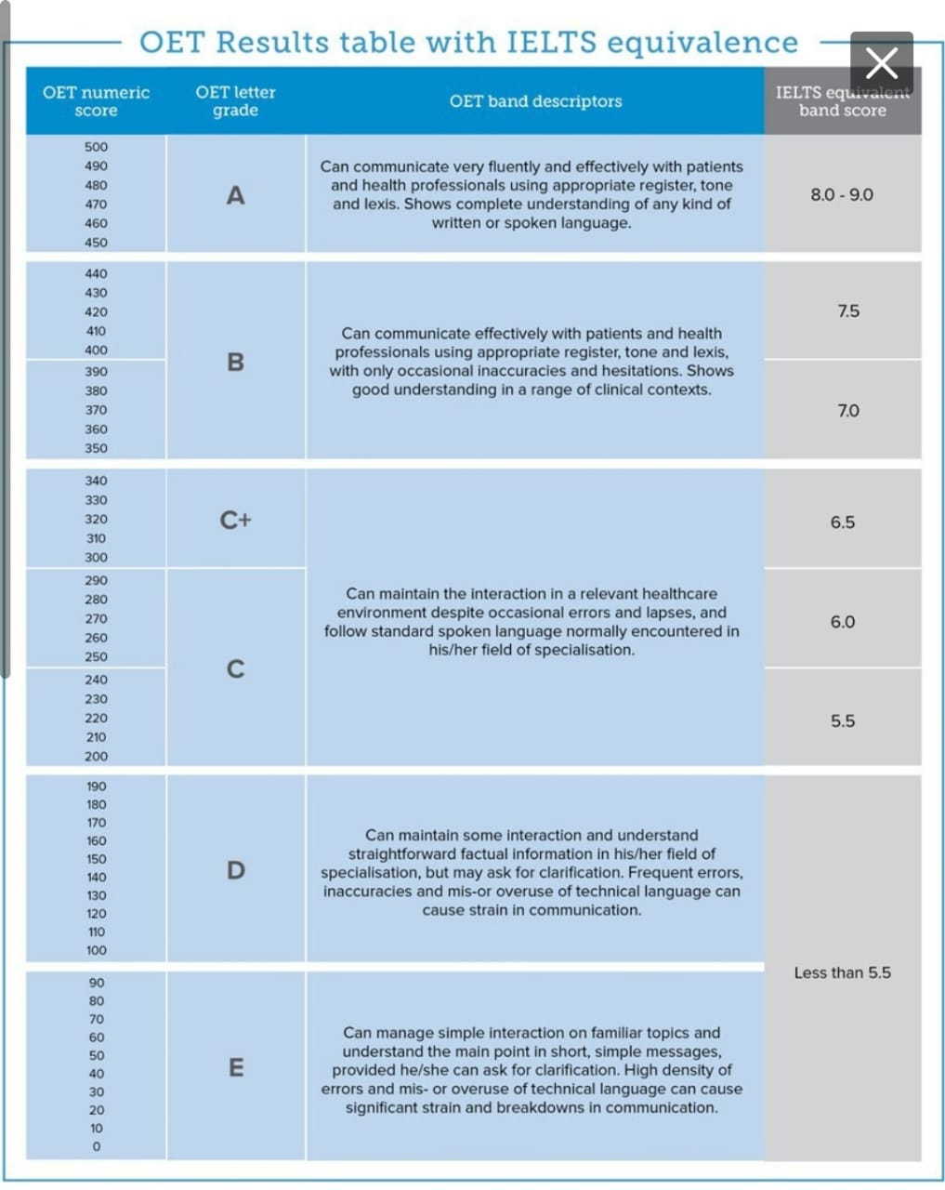

Slide 6
Who can take the exam
The OET exam has been specifically designed for 12 healthcare professions including Occupational Therapy, Dentistry, Nursing, Radiography, Veterinary Science, Medicine, Speech Pathology, Physiotherapy, Dietetics, Podiatry, Pharmacy, and Optometry
Healthcare professionals who are looking to work or study in the healthcare sector in Australia, Canada, Ireland, Maldives, Malta, Namibia, New Zealand, Philippines, Qatar, Singapore, Spain, Ukraine, United Kingdom, United Arab Emirates and the United States of America are required to register for the OET to be able to prove their level of English proficiency to be able to deliver superior healthcare. A lot of times, while registering for the OET Exam candidates are often confused about OET exam eligibility. Read on to know about the OET eligibility guidelines.

Slide 7
OET Eligibility: Age Requirements
CBLA the conducting body of the OET exam has not mentioned any age limit for the OET exam. There are no age criteria for candidates wanting to appear for the OET exam. Hence, candidates wanting to go abroad to countries that accept OET are required to register for the OET exam on the official website, here: https://www.occupationalenglishtest.org/book-oet/.
OET Eligibility: Education Qualification
Again, CBLA has not laid down any specific educational qualifications required by the candidate to appear for the OET Exam. Hence, as long as the student is looking to work in the health care sector he is eligible to apply for the OET exam

Slide 8
OET Paper Pattern 2023
Below is the OET exam pattern in detail.
OET Exam Pattern/ Sections | Test Duration | OET Test Description
Listening | 50 minutes | The Listening subsection is divided into 3 parts that test the candidates listening capabilities in various formats.
Reading | 60 minutes | The Reading subsection is divided into 3 parts that test the candidates reading capabilities in various formats.
Writing | 45 minutes | The Writing subsection is profession-specific and requires candidates to write a letter of reference.
Speaking | 20 minutes | The Writing subsection is profession-specific and requires candidates to enact a roleplay from the healthcare environment

Slide 9
The required mark
For the medical field all the three listening , reading , writing and speaking results must meet the required mark in the country or the facility that they want to proceed their work or education
In the next pages are the list of where the OET exam are accepted therefor you should and search for the specific institute the you are planning to apply for

Slide 10
The following organisations accept OET@Home results:
Healthcare Regulators
College of Physicians and Surgeons of British Columbia (Canada)
Dietitians Association of Australia
Dietitians Board of New Zealand
ECFMG (USA)
General Medical Council (UK)
Maldives Medical and Dental Council
Maldives Nursing and Midwifery Council
Nursing and Midwifery Council (UK)
Occupational Therapy Board of New Zealand
Royal College of Paediatrics and Child Health

Slide 11
Speech Pathology Australia
Washington State Nursing Care Quality Assurance Commission
Education Institutions
Brunel University London (UK)
Hamad Medical Corporation (Qatar)
Jose Rizal Memorial State University (Philippines)
Sydney Shoulder Research Institute (Australia)
Ulster University (UK)
Other Organisations
Health Education England (UK)
IPA Recruitment Solutions (Australia)
Wrightington, Wigan and Leigh NHS Foundation Trust (UK)

Slide 12
Thank you

